Slide 1

Bode Stability Criteria uses the open loop characteristic to predict the closed-loop behavior
D
G_{d}(s)
SP
MV
E
CV
u₂
G_{c}(s)
G_{v}(s)
G_{p}(s)
CV_{m}
G_{s}(s)
D
G_{d}(s)
SP
MV
E
CV
u₂
G_{c}(s)
G_{v}(s)
G_{p}(s)
CV_{m}
G_{s}(s)

Slide 2
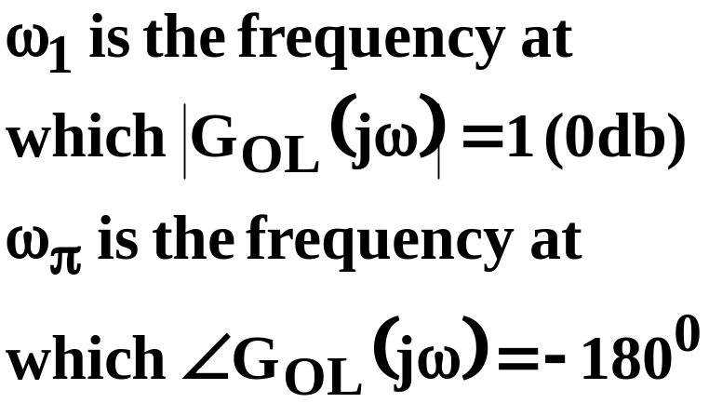
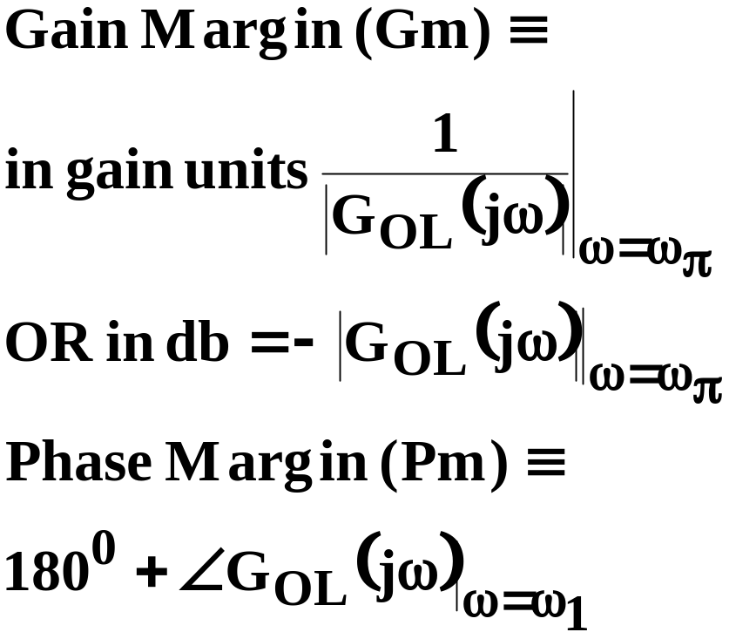
OPEN-loop Landmarks
|G_{OL}|
0 db
ω₁
LG_{OL}
ω_{π}
-180º

Slide 3
frequency-DOMAIN guidelines for “good” OPEN-loop that results in “good” CLOSED LOOP
Larger 0 dB crossing, ω₁, means larger closed-loop bandwidth and shorter rise time
Large |G_{OL}| at low frequency means small offset
Gain margin >1 (>0 db) required for closed-loop stability; >2.5 (8db) recommended for performance
Phase Margin >35º for small resonant peak in the closed-loop, good damping, and good decay ratio.
NOW want to see how to ADD COMPONENTS to a feedback loop (PID, RECYCLE, etc) to get these desirable frequency response characteristics

Slide 4
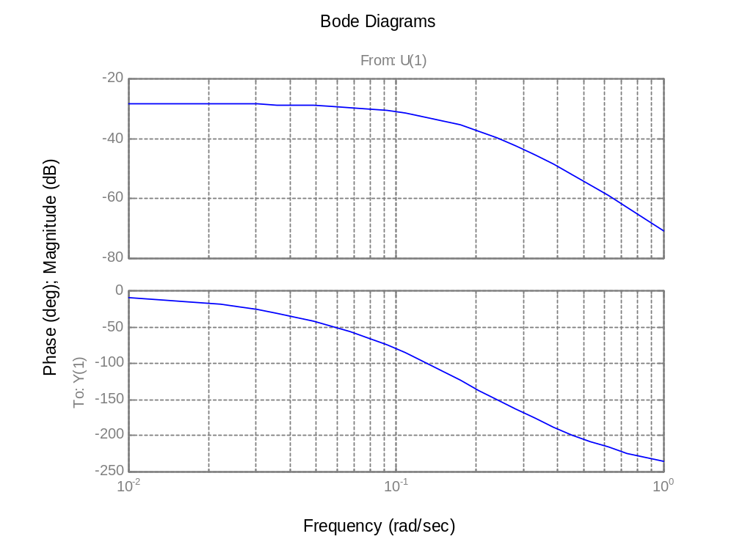
BODE diagram of 3 tank mixing with K_{c}=1, T_{I}=infinity, T_{D}=0
( i.e., G_{OL}(j)=1.0 * G_{v}(j)G_{P}(j)G_{s}(j) ) bode(0.039, conv([5 1],conv([5 1],[5 1])))
0 db
No 0 db crossing, implies slow response
Low gain at low  means poor offset
Large gain margin means “really stable”
INFINITE phase margin (no ₁ crossing) means “well damped”
Gm ~50db
-180º

Slide 5
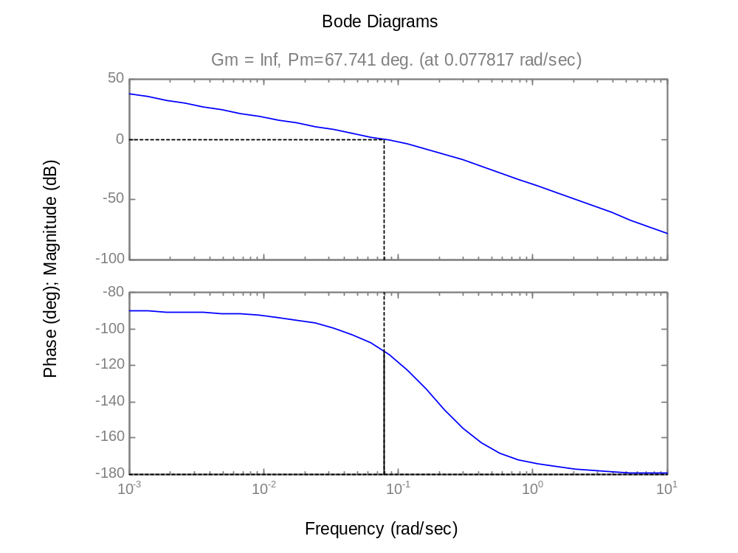
BODE diagram of 3 tank mixing with K_{c}=21, T_{I}=10, T_{D}=2
( i.e., G_{OL}(j)= G_{c}(j) G_{v}(j)G_{P}(j)G_{s}(j) ) margin(0.039*21*[20 10 1],conv([10 0],conv([5 1],conv([5 1],[5 1]))))
0 db ω₁= .08 rad/min
Large gain (infinite) at low ω means Good offset
Infinite gain margin (no ω_{π} ) means “really stable”
phase margin of 67º>35means “well damped response
0 db
Pm= ~ 67º
-180

Slide 6
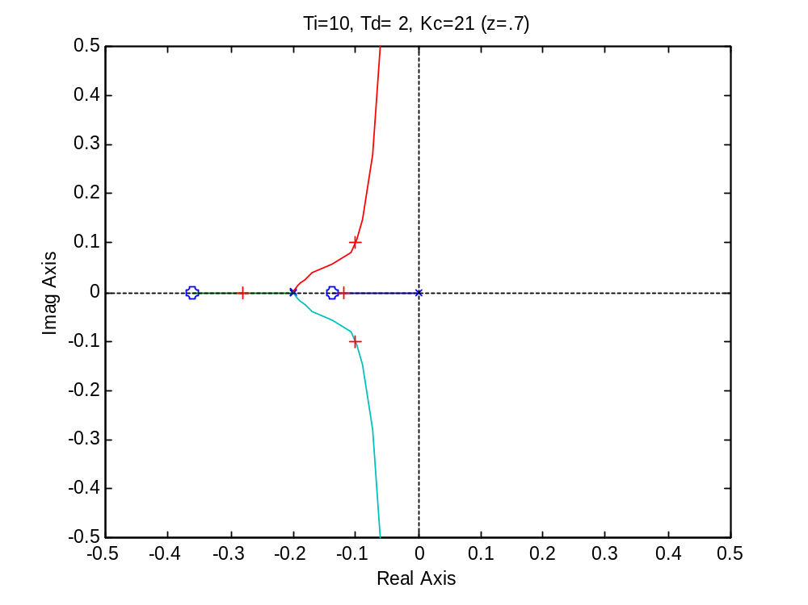
rlocus(conv([Ti*Td Ti 1],num),conv([Ti 0],den)) where num, den were exact (not first order with delay)
Kc=21
Open loop poles at s=0, -1/5, -1/5, -1/5
Open loop zeros, Td=2, TI=10
–0.14, -0.36

Slide 7
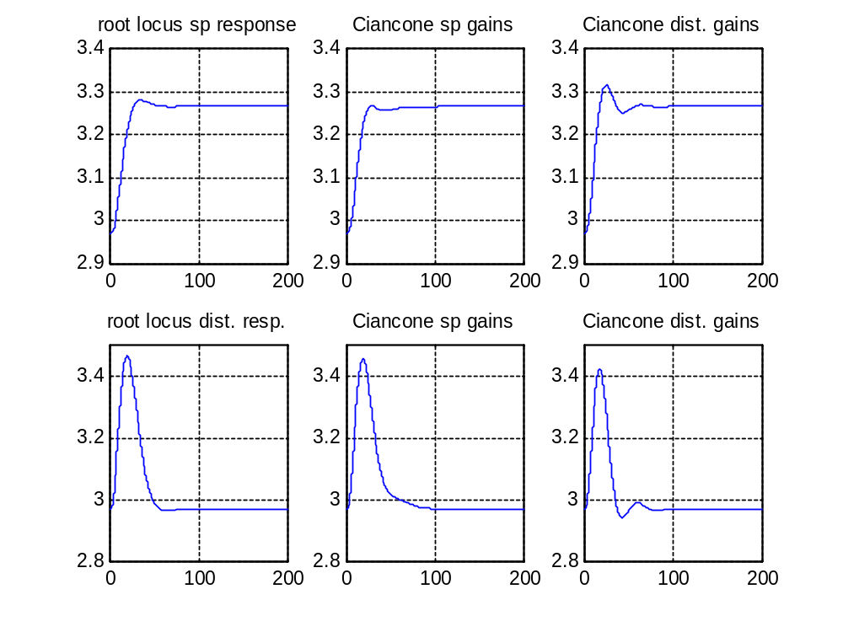
Comparison of time responses
Setpoint response with setpoint gains
Setpoint response with disturb. gains
Disturbance response with setpont gains
Disturbance response with disturb. gains

Slide 8
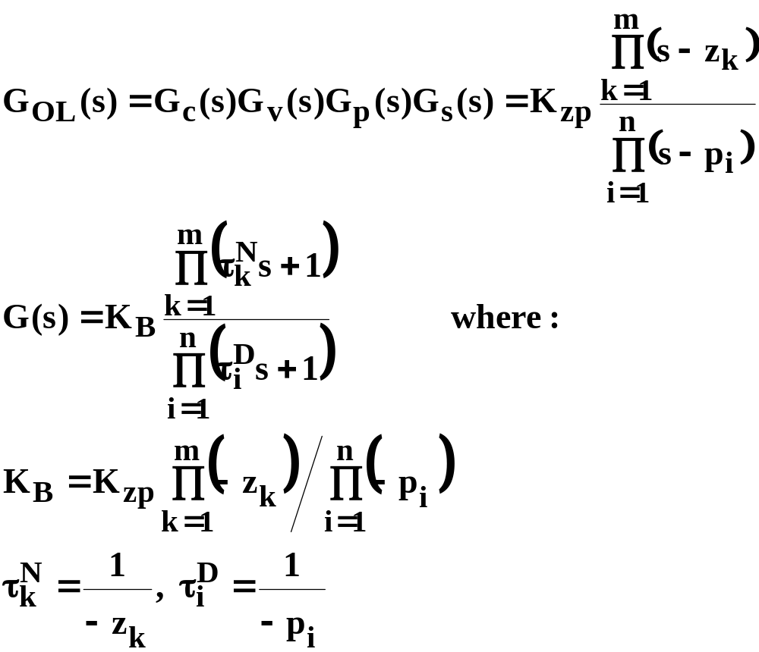
Bode Diagram Sketching Rules
First must put into Bode Form with +1 at all the constant terms

Slide 9
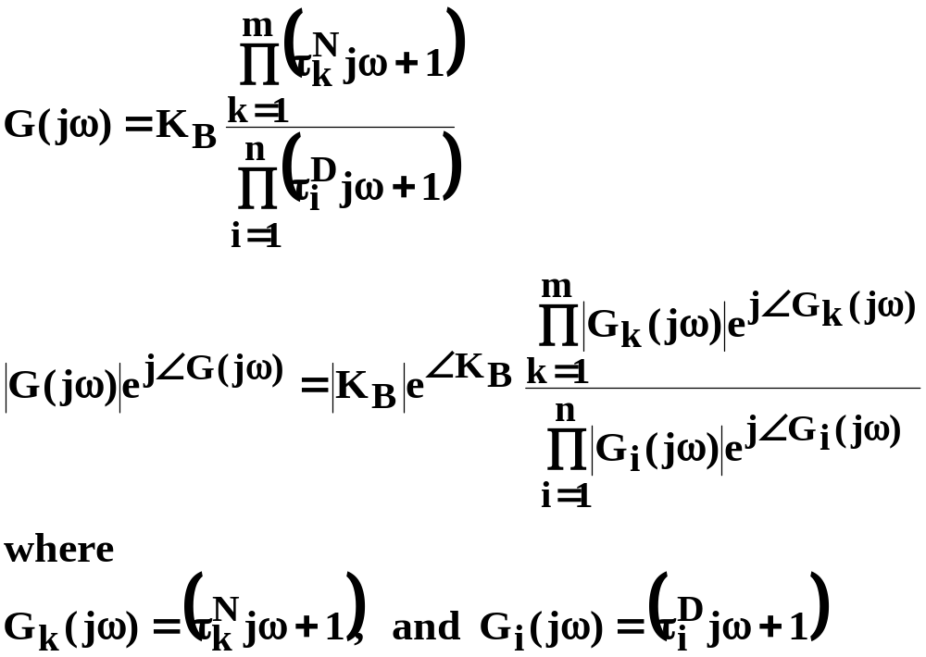
Bode Diagram Sketching Rules, jω
Next get the frequency response by substituting s=jω
And note that each numerator or denominator component is a complex number that can be represented in polar form with magnitude and phase

Slide 10
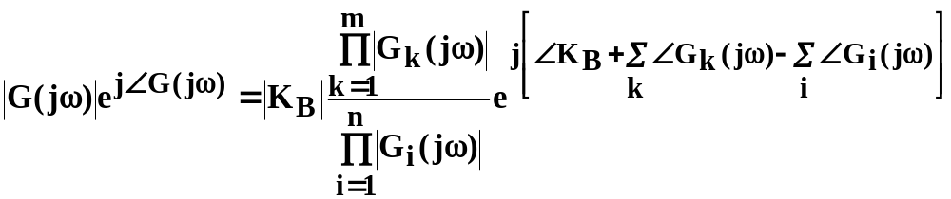
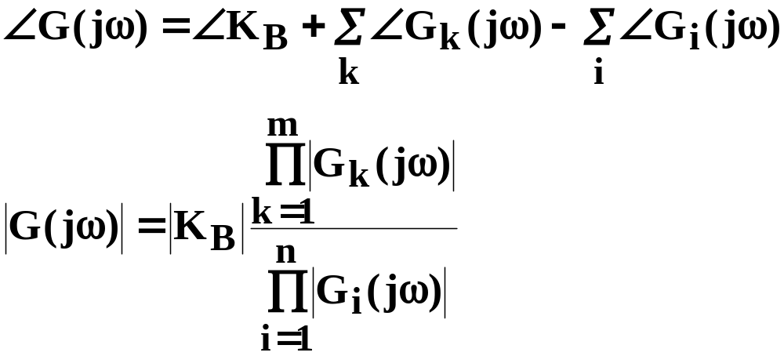
Bode Diagram Sketching Rules, collect exponetial terms:
AND Equate magnitude and phase on each side

Slide 11
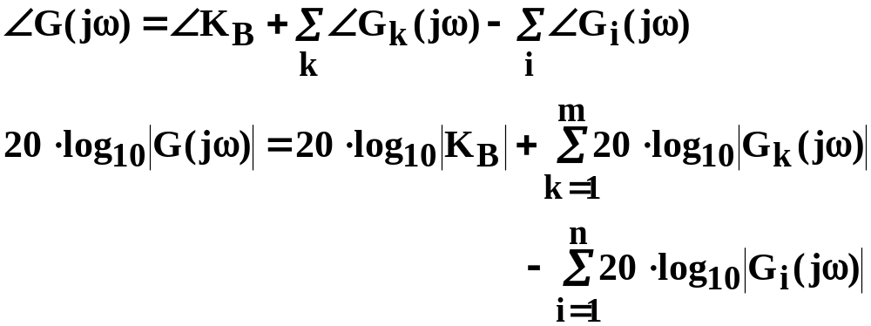
Use logarithms to convert magnitude multiplication to addition problem
Combining phase angles and logarithms-of-magnitudes is an addition problem that can be graphically constructed.
NOTE that the numerator components are ADDED while the denominator components are SUBTRACTED

Slide 12
Since numerator and denominator contributions have the same form, we only need one set of sketching rules.
With sketching rules for numerator components, then we just have to remember to SUBTRACT the results if a component is in the denominator!!

Slide 13
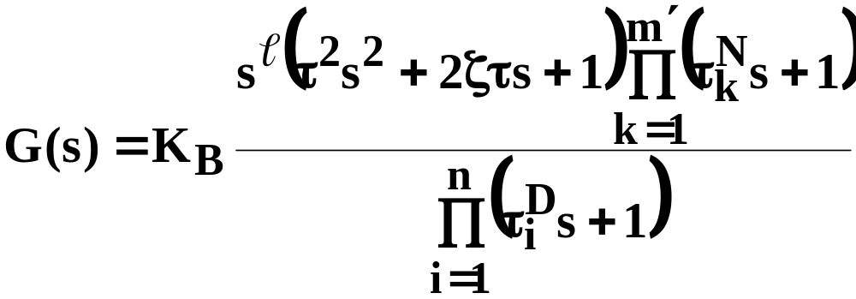

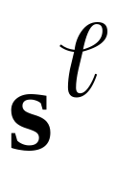
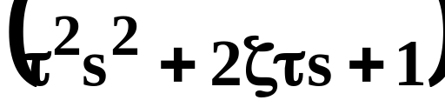

There are only 4 possible numerator components to learn to sketch
Constant term
Numerator zeros at the origin,
Numerator quadratics
Numerator time constants

Slide 14




1 of 4: The rules for Sketching K_{B}
K_{B} is a real number, which can be positive or negative
Magnitude is simply |K_{B}|
PHASE depends on the sign
  K_{B}>0 means the phase is 0º
  K_{B}<0 means the phase is –180º
s-plane
s-plane
Imag. axis
Imag. axis
Real axis
Real axis

Slide 15
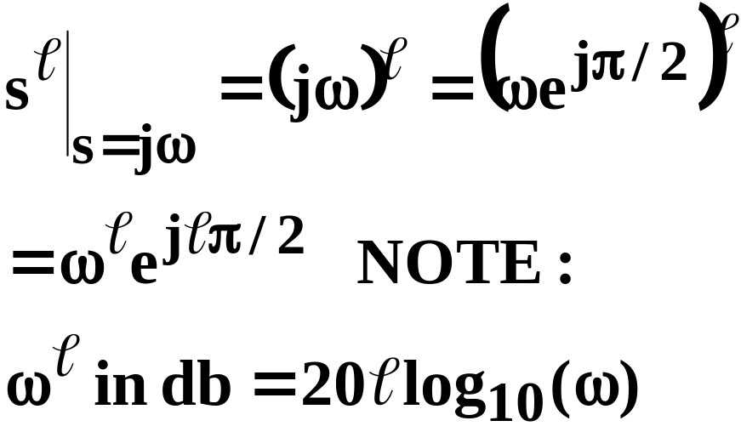


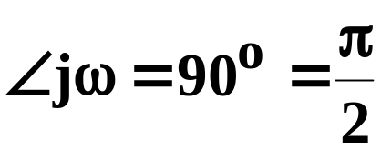
2 of 4: Repeated zeros at the origin
Magnitude has a constant slope of +20 db/decade
Crosses 0 db ω=1
Phase is constant at + 90 º
(Note if
it is in the denominator, slope and phase are negative)
s-plane
Imag. axis
s=jω
Real axis

Slide 16

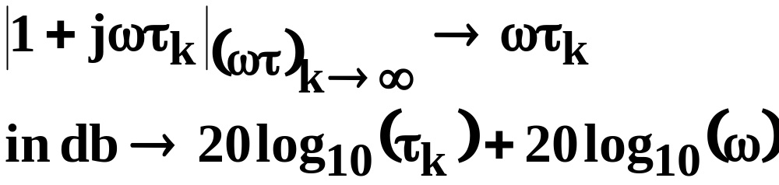
3 of 4: Numerator time constants τ_{k}>0
As ω approaches 0, magnitude approaches 1 (0db), phase approaches 0º
As ω becomes large magnitude approaches ωτ_{k}, phase approaches +90
Asymptotes intersect at ω_{Β}=1/τ_{k}
Magnitude increases 20 db/decade above the break
Imag.
axis
s=1+jωτ_{k}
s=1
Real
axis
s-plane

Slide 17
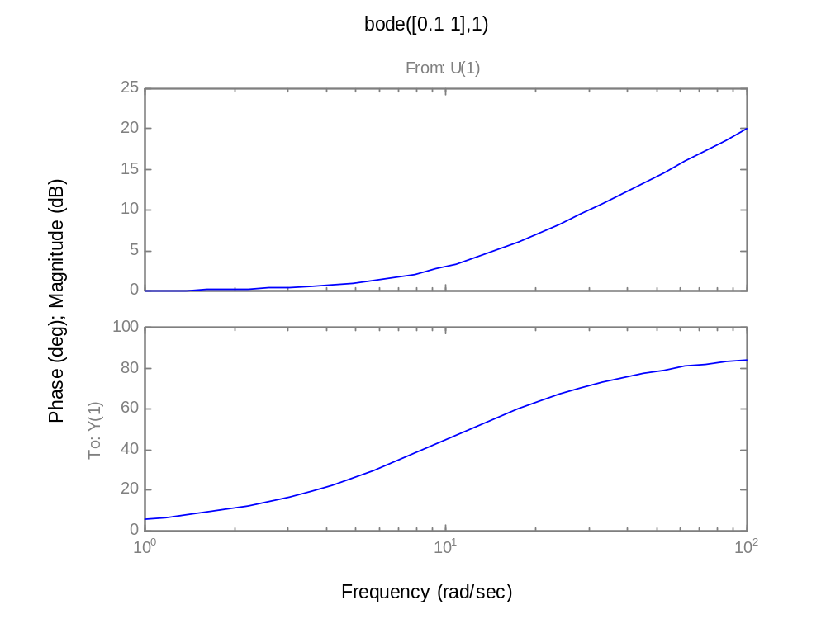
Numerator time constant Bode Diagram bode([0.1 1],1]), τ>0
Asymptotic slope is +20 db/decade;
Asymptotes intersect at the break frequency: ω_{b}=1/τ;
ω_{b}=1/τ
Slope of phase plot extrapolates to 0 degrees at 1/5 ω_{b}
Slope of phase plot extrapolates to +90º degrees at 5 ω_{b}
Phase angle is half –way between its asymbtoic values at ω_{b}

Slide 18
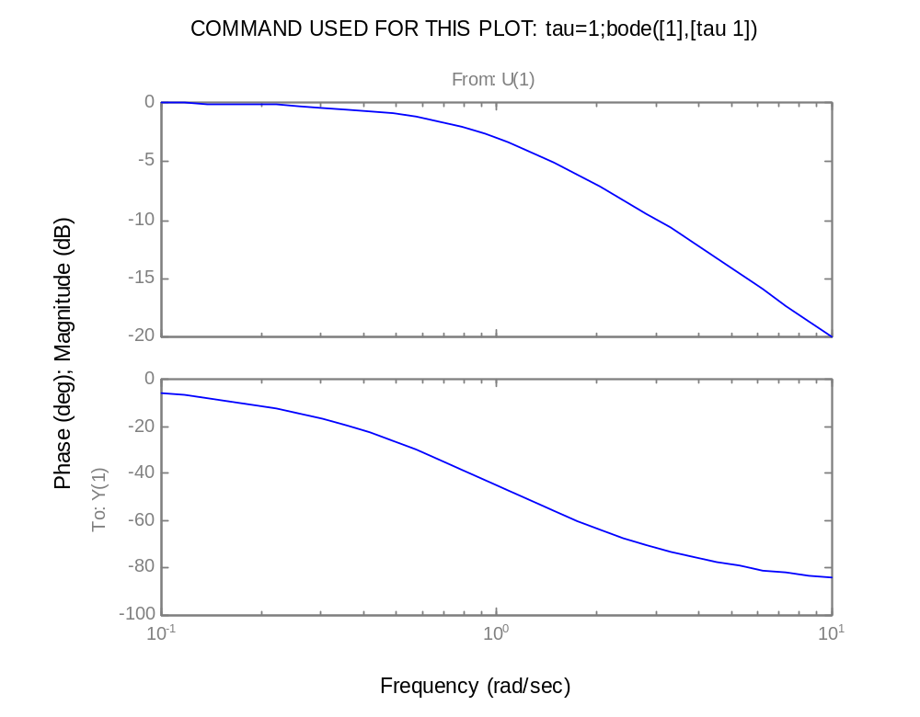
Denominator time constant Bode Diagram bode(1,[1 1]), everything is inverted
Asymptotic slope is –20 db/decade;
Asymptotes intersect at the break frequency: ω_{b}=1/τ;
ω_{b}=1/τ
Slope of phase plot extrapolates to 0 degrees at 1/5 ω_{b}
Slope of phase plot extrapolates to –90º degrees at 5 ω_{b}
Phase angle is half –way between its asymbtoic values at ω_{b}

Slide 19
3 of 4: WATCH OUT FOR Numerator time constants τ_{k}<0 (zero in the RHP)
As ω approaches 0, magnitude approaches 1 (0db), phase approaches 0º
As ω becomes large magnitude approaches ωτ_{k}, phase approaches -90
Asymptotes intersect at ω_{Β}=1/τ_{k}
Magnitude increases 20 db/decade above the break (Magnitude is just distance from the origin.)
Imag.
axis
s=1
Real
axis
s-plane
s=1+jωτ_{k}
(τ_{k}<0)

Slide 20
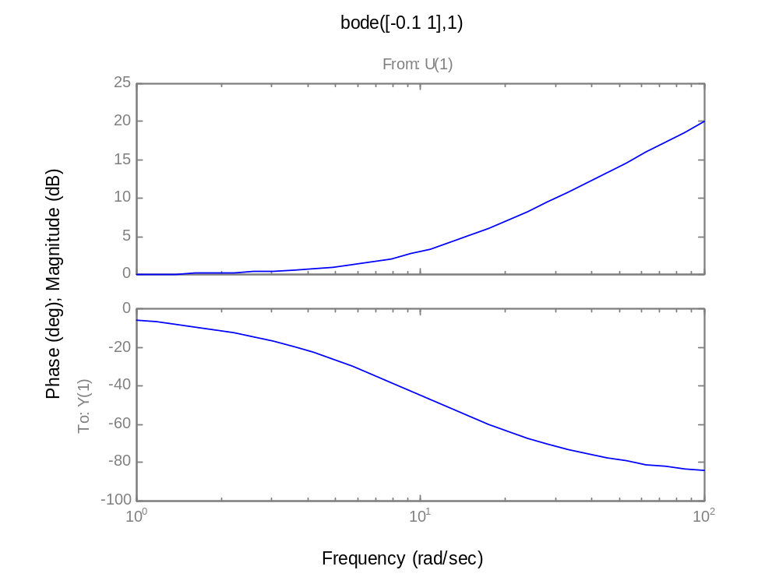
Numerator time constant Bode Diagram bode([-0.1 1],1]), τ<0
Asymptotic slope is +20 db/decade;
Asymptotes intersect at the break frequency: ω_{b}=1/τ;
ω_{b}=1/τ
Slope of phase plot extrapolates to 0 degrees at 1/5 ω_{b}
Slope of phase plot extrapolates to –90º degrees at 5 ω_{b}
Phase angle is half –way between its asymbtoic values at ω_{b}

Slide 21
time constants repeated
High frequency asymptotic slopes are just multiplied by the order of the root.
High frequency phase is just multiplied by the order of the root
High frequency phase at the break is multiplied by the order of the root.
The 0.2 ω_{b} and 5 ω_{b} corners still apply.

Slide 22
Quadratic terms (-1<ζ<1)
Quadratics are simply sketched as time constants repeated twice
  If (ζ>0), numerator slope is 40 db/decade, phase goes to +180º
  If (ζ<0), numerator slope is still 40 db/decade, phase goes to –180º
  Denominator rules have opposite signs for slope and phase.

Slide 23
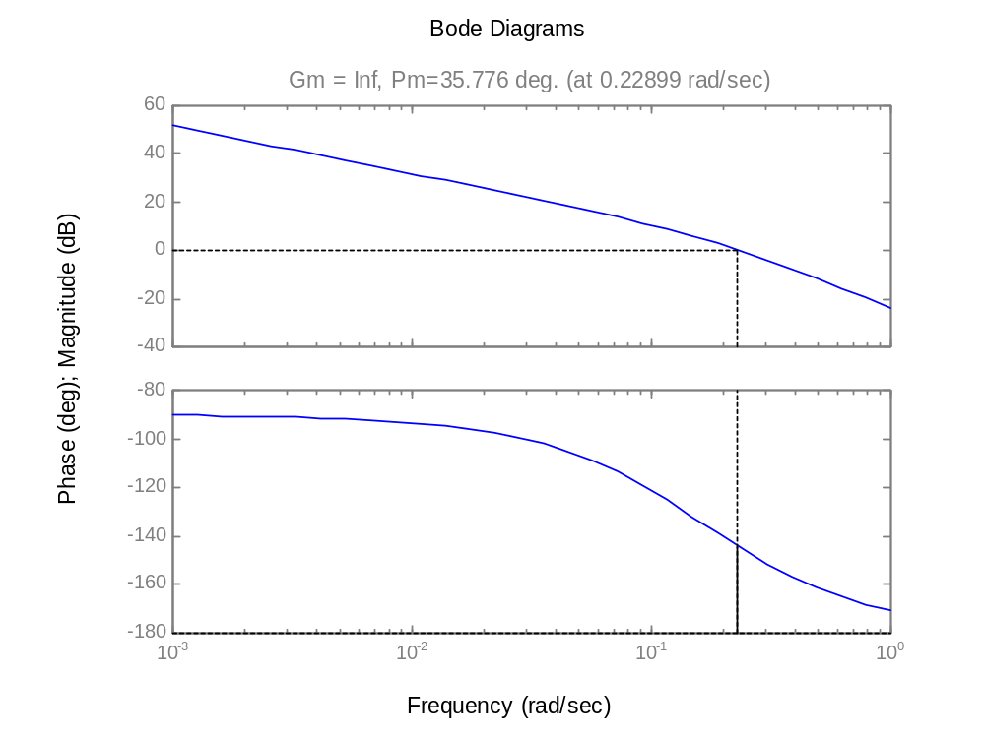
BODE diagram of 3 tank mixing with K_{c}=90, T_{I}=9, T_{D}=2.3 from the Ziggler Nichols Ultimate Period Method (K_{c}=120) margin(0.039*90*[20.7 9 1],conv([9 0],conv([5 1],conv([5 1],[5 1]))))
0 db ω₁= .08 rad/min
Large gain (infinite) at low ω means Good offset
Infinite gain margin (no ω_{π} ) means “really stable”
phase margin of 67º>35means “well damped response
0 db
Kc=120
Kc=90
Pm= ~ 36º
-180

Slide 24
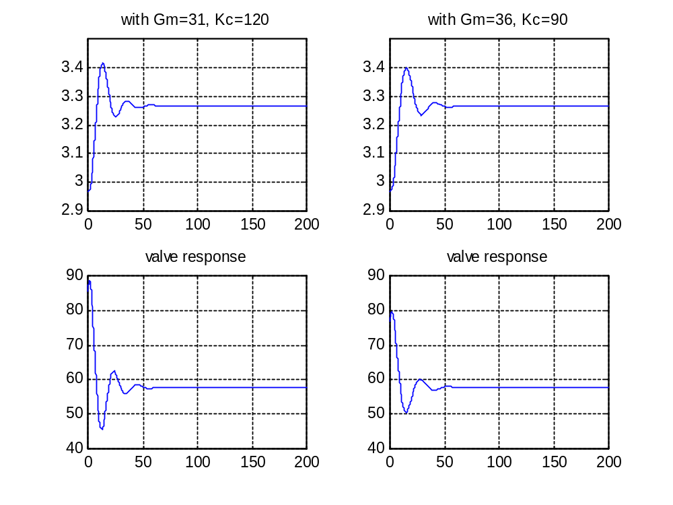
Time response with Pm=31, Kc=120 (left) Pm=36, Kc=90 (right)

